Slide 1
ITEC 1150 Introduction to Programming Logic and Design
Welcome!

Slide 2
Agenda
Welcome, introductions
About the class
About programming and software engineering
Required software
D2L, class structure and assignments
Syllabus and class expectations
Writing your first program
How to get help
Lab 1

Slide 3
Welcome!
I'm Clara James, please call me Clara
I've been working with computers ~25 years
Former software engineer, I've been teaching at MCTC since 2012
I think programming is really fun, interesting, and useful
Fun to solve problems, and learn new things
There's always new things to learn
Can save a lot of time at home and at work by automating boring tasks with programming (more on that in a few minutes)

Slide 4
Class Objectives
Learning about programming, being able to write basic programs to solve problems
For software engineers: preparation for 2nd year programming classes
For everyone: appreciating how programming fits into the information technology world. e.g. network administrators often need to install custom software, and helpdesk agents support software
Being able to automate repetitve or boring tasks
Useful for anyone in information technology. Automation is for network administration, information security, forensics --- programming is not just for programmers!

Slide 5
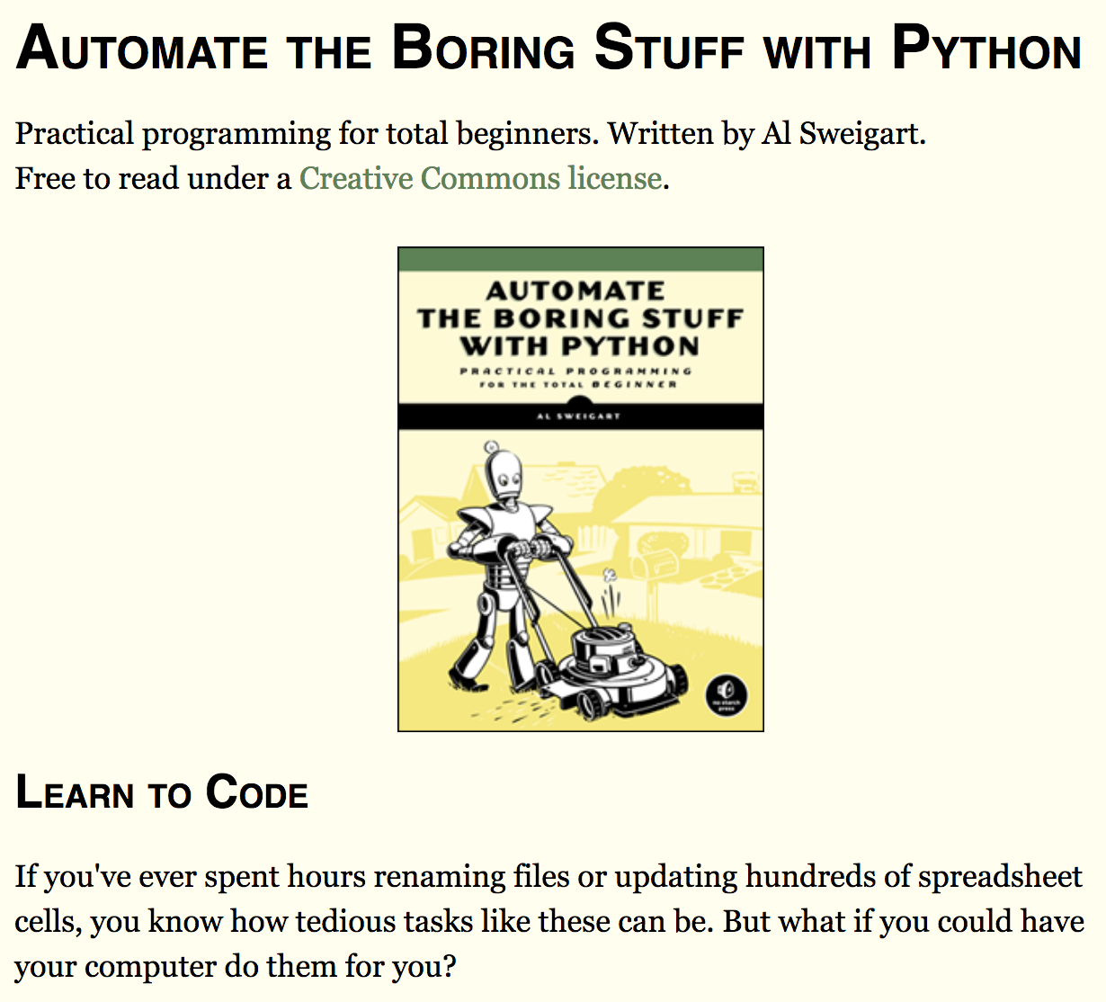
Textbook
Free online, 2nd edition
https://automatetheboringstuff.com/
Print copies (not free) at the bookstore
First half: Python programming basics
Second half: doing useful things with Python

Slide 6
Programming
Software applications are everywhere
Websites, mobile apps, applications on your computer, in cars, televisions, video games, smart watches/thermostats/cameras....
Computers, cellphones, other electronics can't do anything without software
Software is the instructions that tell a computer what to do
Programming or software engineering is writing the instructions - programming code - for software
There are many different programming languages, each used for different types of software

Slide 7
Many different programming languages
Windows desktop applications can be written in C# or C++ or Java (or one of many other languages)
Android apps are written in Java or Kotlin
iPhone apps are written in Swift
Interactive web pages are written in JavaScript
Operating systems (like Windows, OSX, Linux) are written in C and C++
Automotive computers and spaceships may be programmed in C
Web applications can be written with Java or PHP or Python or Ruby (or one of many other languages)
Programs that analyze data can be written in Python or R
And there are many other programming languages for other applications

Slide 8
Python programming language
Python is good for building small programs
It is fast to set up and start using
Can write quick, simple scripts for a particular task
It's free
It runs on most platforms
But it is also good for building big, complicated things

Slide 9
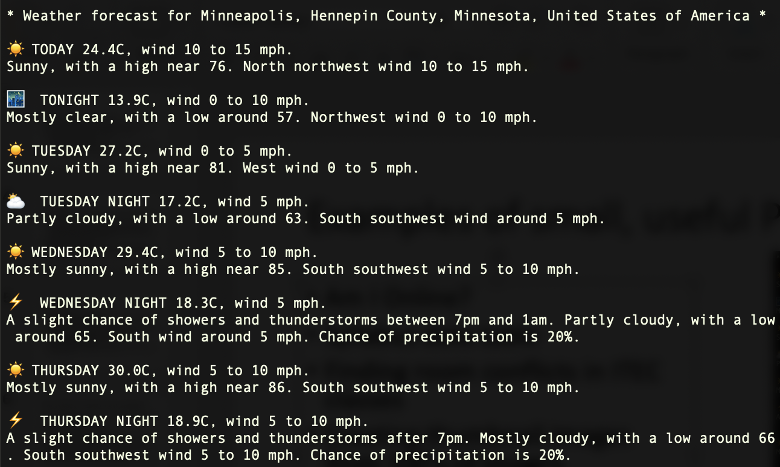
Examples of small, useful Python programs
Am I Online?
Syllabus date table
Finding room conflicts in ITEC classes
Downloading data from the internet (e.g. minimal weather program)
Finding files on a computer

Slide 10
More examples of small, useful Python programs
From the textbook:
Downloading all the comics from a web site
Telling you what the current weather is
Sending emails
Creating thumbnail images from 100's of images
Filling out forms on web pages
Working with Excel documents and PDFs

Slide 11
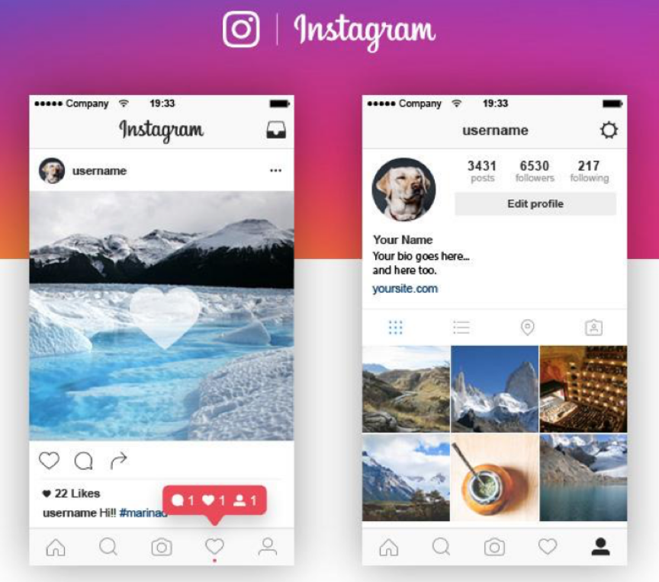
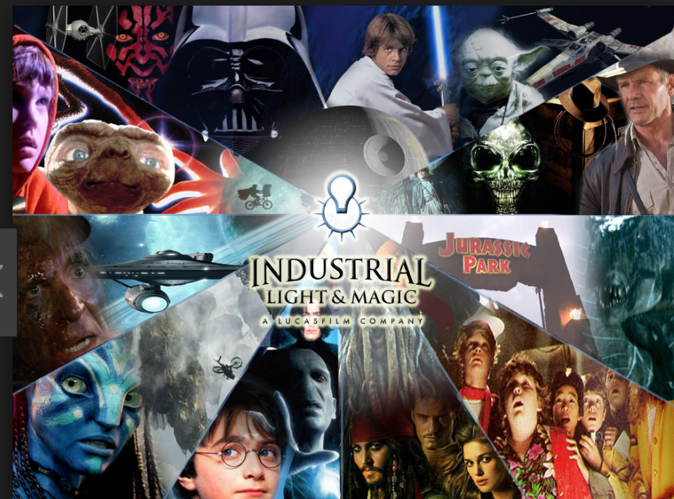
Big Python programs
Instagram
Instagram is almost entirely built in Python, and is one of the world's largest Python applications
Industrial Light & Magic uses Python tools to generate animation and special effects for movies and television

Slide 12
More companies that use Python...
Facebook, Google, Netflix, YouTube, Dropbox, Microsoft, Hulu, Amazon, LinkedIn, Bloomberg, Yelp, Reddit, Patreon, Capital One, IBM, Square, OfferUp, Pluralsight, Shopify, Indeed, Twitter, Goldman Sachs, REI, The New York Times, Venmo....
Python is commonly used for automating software and networking tasks at companies like these
It’s also used for data processing and analysis
Python programs help manage networks, computers and applications, and keep things running smoothly

Slide 13
What will you learn in this class?
You'll learn the basics of programming in Python
While there are many different programming languages, the basic concepts and principles of programming are very similar in many different programming languages
So learning one programming language prepares you to learn any other programming language

Slide 14
What will you learn in this class?
We'll work on some projects where Python will do some useful tasks for us, for example
Automatically download and process data from the internet
Generate Microsoft Word and Excel reports and spreadsheets

Slide 15
Class Structure – Weekly Tasks
First: watch the lecture video
Introduce programming concepts,
You should pause the video and write the same programs
Save all the code you write
Post in the weekly discussion
And respond to other students, you may need to check back later
Attend online lab session via Zoom to start work on the lab
Every Wednesday 10-11.50am
Finish the rest of the lab as homework
Labs are due Sundays at midnight

Slide 16
Final Project
Last three weeks of class are for working on a project that ties all the things you've learned together
More info on this in D2L, and given in class nearer the time

Slide 17
Tour of D2L
Parts of D2L you'll use:
Announcement: on the front page for the class
Materials > Content: all the slides, links for labs, syllabus, other resources including these videos and slides
Communication > Discussions: you'll post here every week
Assessments > Assignments: you'll turn some work in here
Assessments > Grades: your grades
Communications > Classlist or Email: contact me or other students here

Slide 18
Syllabus
Find the syllabus in Content > Syllabus
Let's review the important parts
Please read the entire syllabus, and ask if you have any questions

Slide 19
Required Software
We need something to write our program code in – a code editor
These are also referred to as Integrated Development Environments, or IDE
We need a program to run our code - for Python, that's a program called an interpreter

Slide 20
Interpreter?
We'll write our programs as text
The program code is instructions in a specific format that Python understands
But the program code by itself doesn't do anything
To run your program code, and for the program to do something, you need an interpreter
The Python program you downloaded earlier contains an interpreter
The interpreter is another program that reads your program code file, figures out what each instruction means, and carries out that task

Slide 21
Installing software on your own computer
All software is free
All software can be installed on Windows PCs, Macs, and many versions of Linux
You'll need to install the following IN THIS ORDER
Python 3.8- this includes the Python interpreter
PyCharm Community Edition - this is a code editor or IDE

Slide 22
Required Software – Computer Lab
MCTC's Academic Success Center Lab computers have all the software you need installed
3rd floor of the T Building, T.3200
Check their opening hours https://www.minneapolis.edu/student-services/academic-success-center

Slide 23
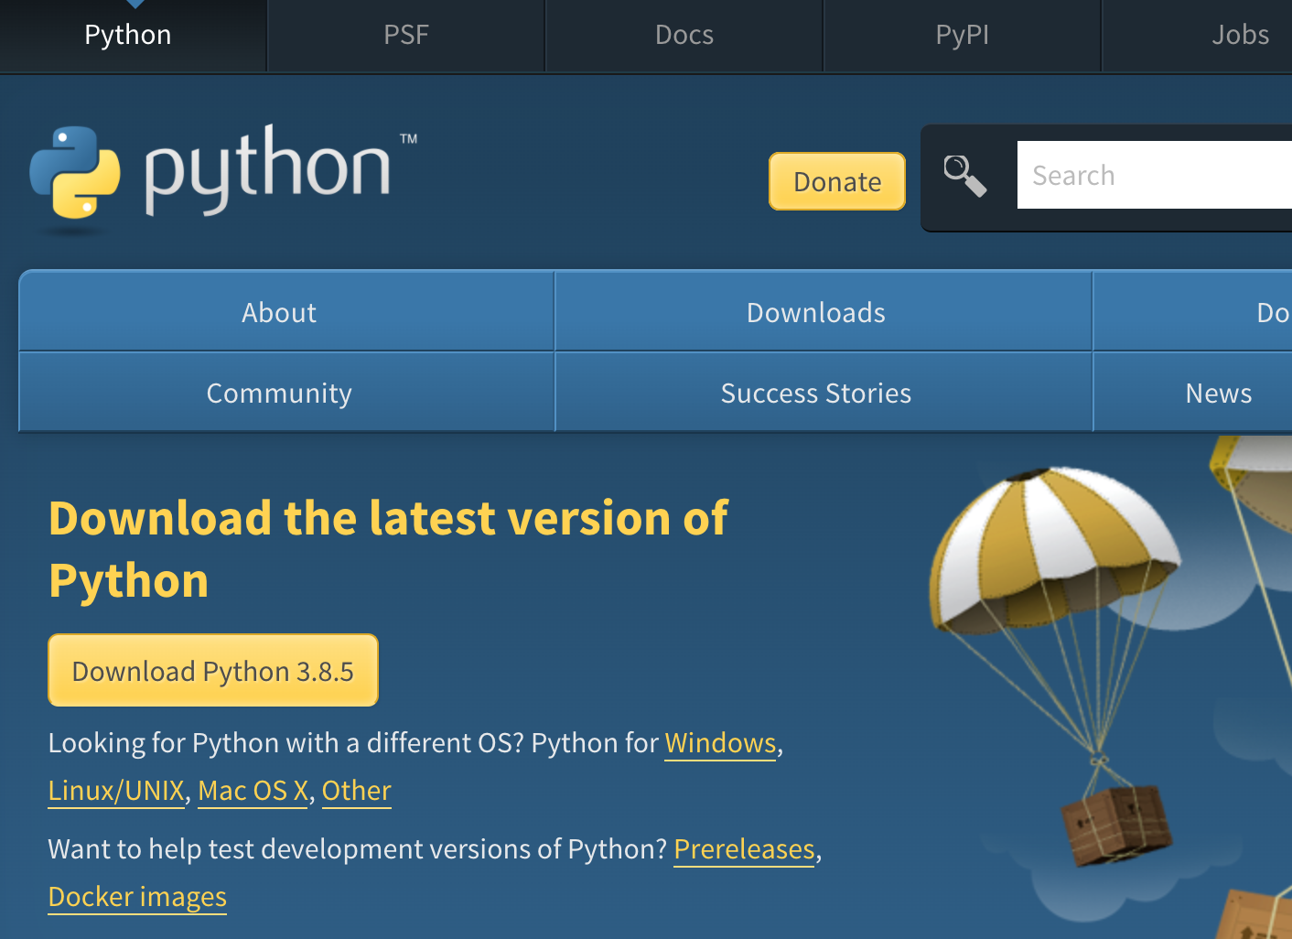
Installing Python
Install the latest version from https://www.python.org/downloads/
Download and run the installer
Defaults are good for all the choices

Slide 24

Installing PyCharm
https://www.jetbrains.com/pycharm/
You'll download the free Community edition
Click the Download Now button

Slide 25
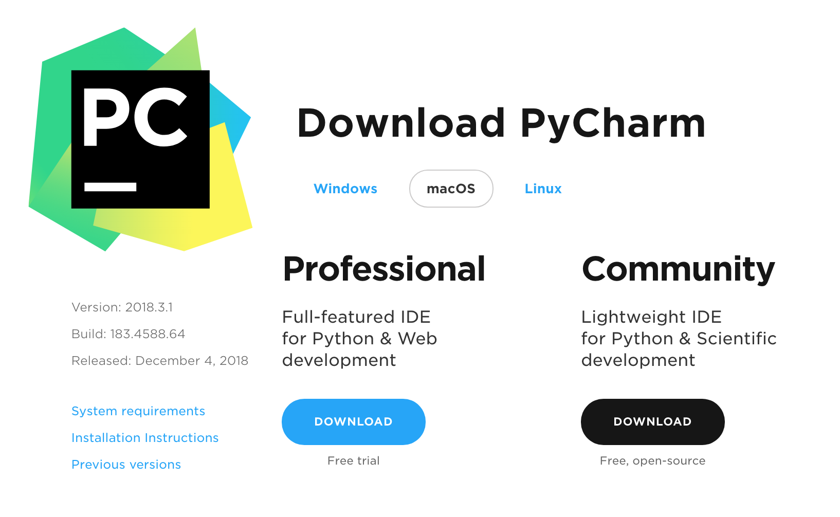
Download the Professional Edition
Click the black button for the Community Edition

Slide 26
First Program!
You should have installed PyCharm
Open PyCharm
Color scheme choice -> either, whichever you want, you can change later if you want

Slide 27
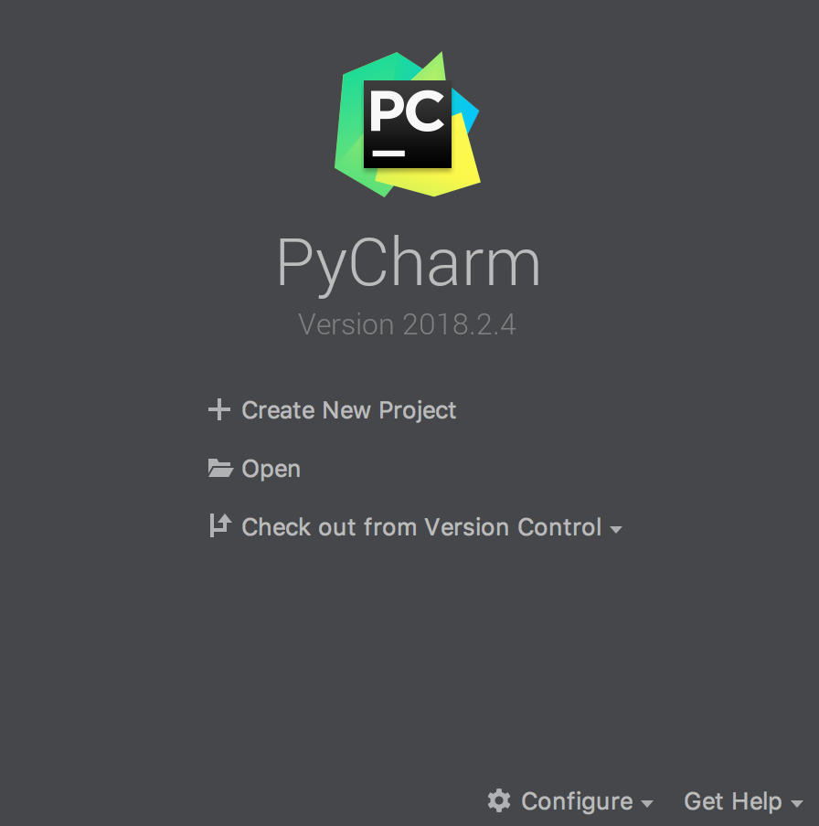
Open PyCharm
And you should see this screen
Click Create New Project

Slide 28
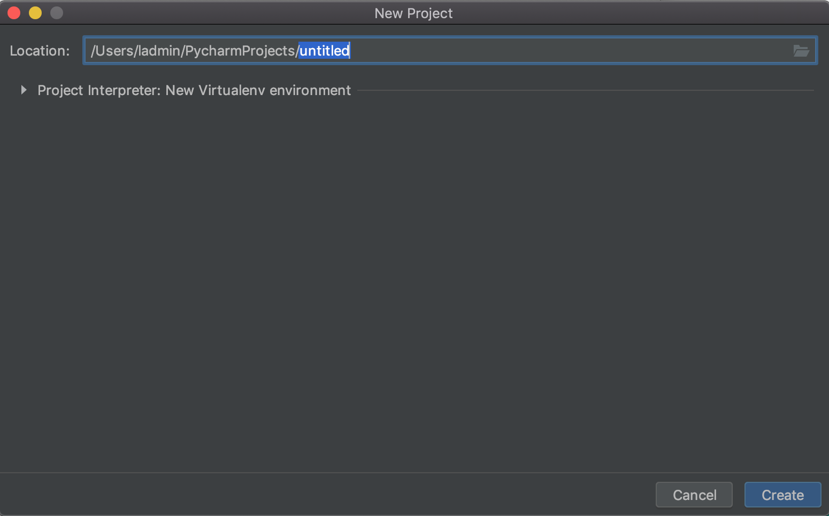
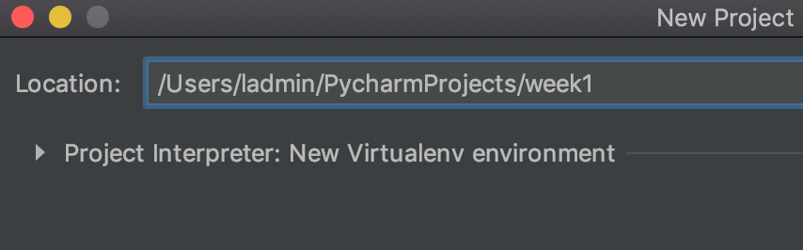
Project settings
PyCharm asks you where to save your work
Notice the word untitled is highlighted in blue
Delete untitled and replace with week1
Change this location if you like
Or it's ok to leave it as suggested - make a note of the location

Slide 29
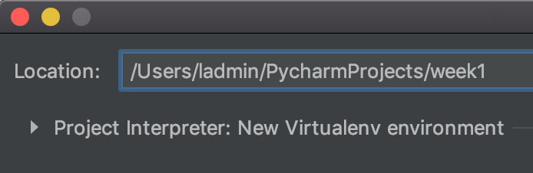
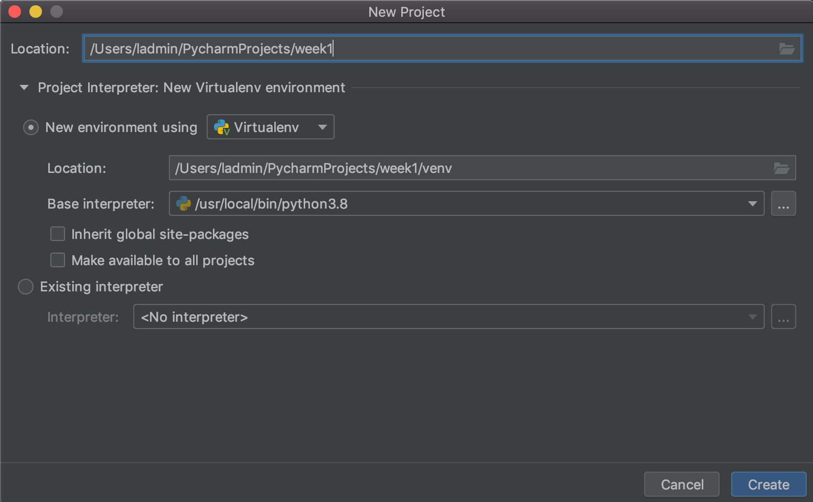
Project settings verify interpreter
Click on the small triangle next to Project Interpreter: New Virtualenv environment
You should not see any errors here
If there's an error message, check that you have installed Python – install Python if needed
Ask for help if you still see errors
There should be Python 3.7.1 selected in this box
Ask for help if not!

Slide 30
Click Create to create new project
Click Create button

Slide 31
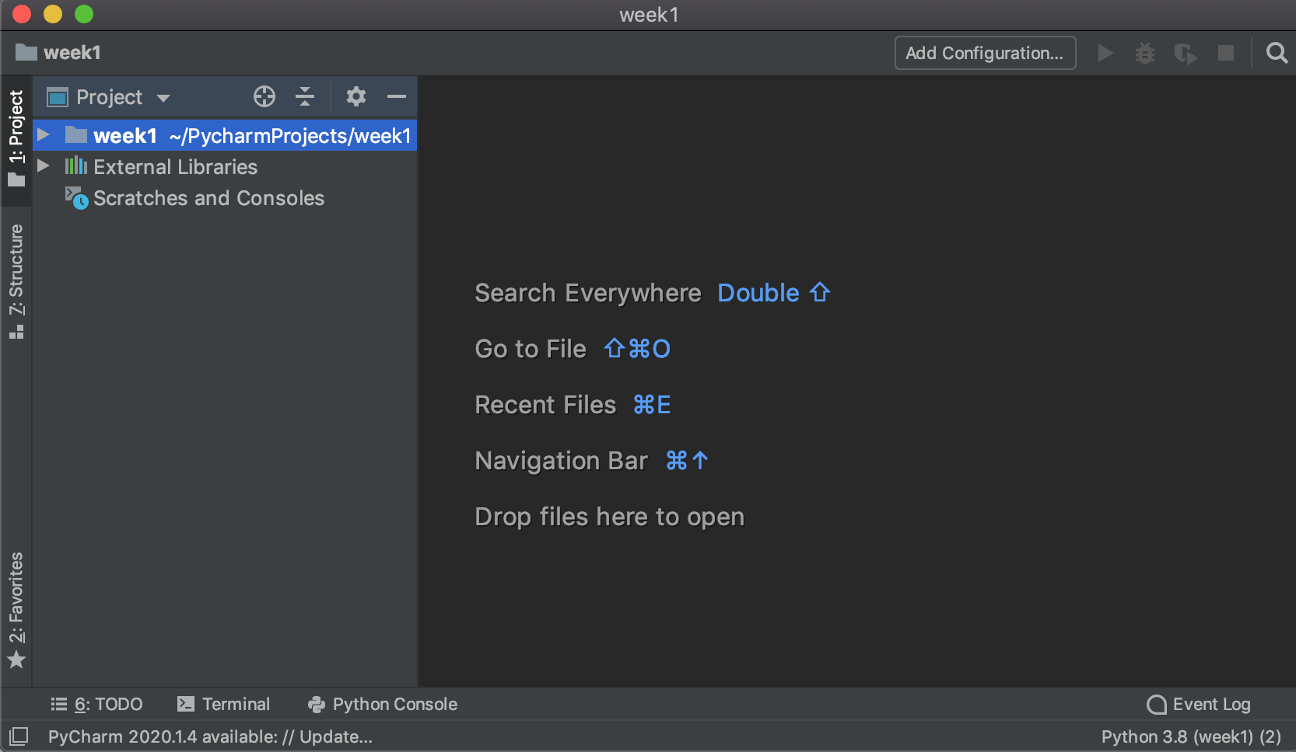
New Project
A PyCharm project is for managing one or more Python files, and any associated files that are needed for running the program
Left: file manager
Right: used for editing files when they've been created
Let's create a new Python file
Project file manager
File editor

Slide 32
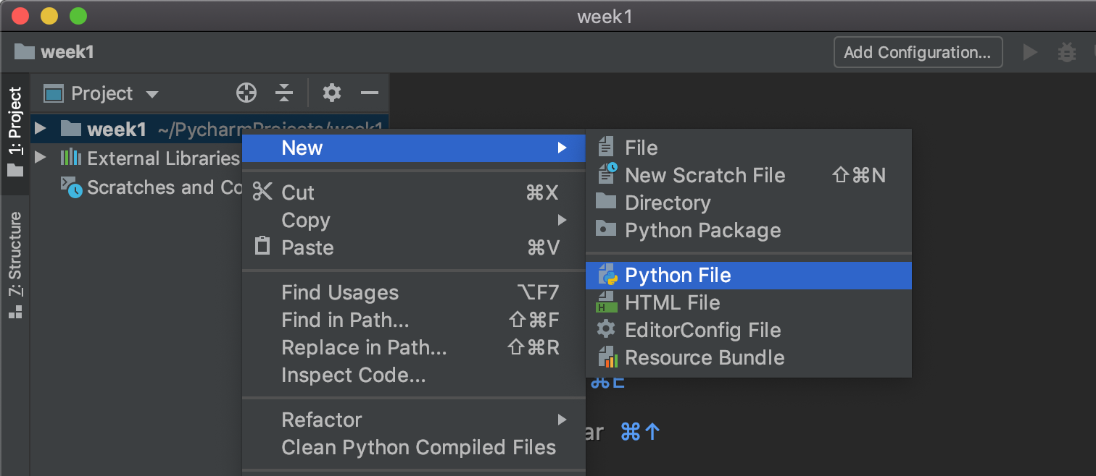
Create a Python file in the new project
Look on the left side of the screen, for your project name
week1 if you changed it, or whatever you changed it to
Right-click on your project name
Select New and then select Python File
Your project name

Slide 33
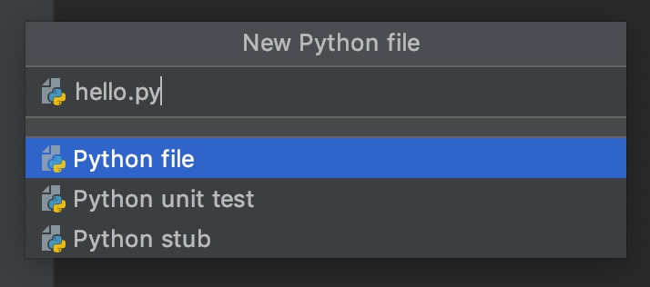
Call your file hello.py
Type hello.py in the Name box. Python files have .py extensions
Verify Python file is highlighted in blue
Press Enter to create the new file
Type hello.py here
Make sure Python file is selected

Slide 34
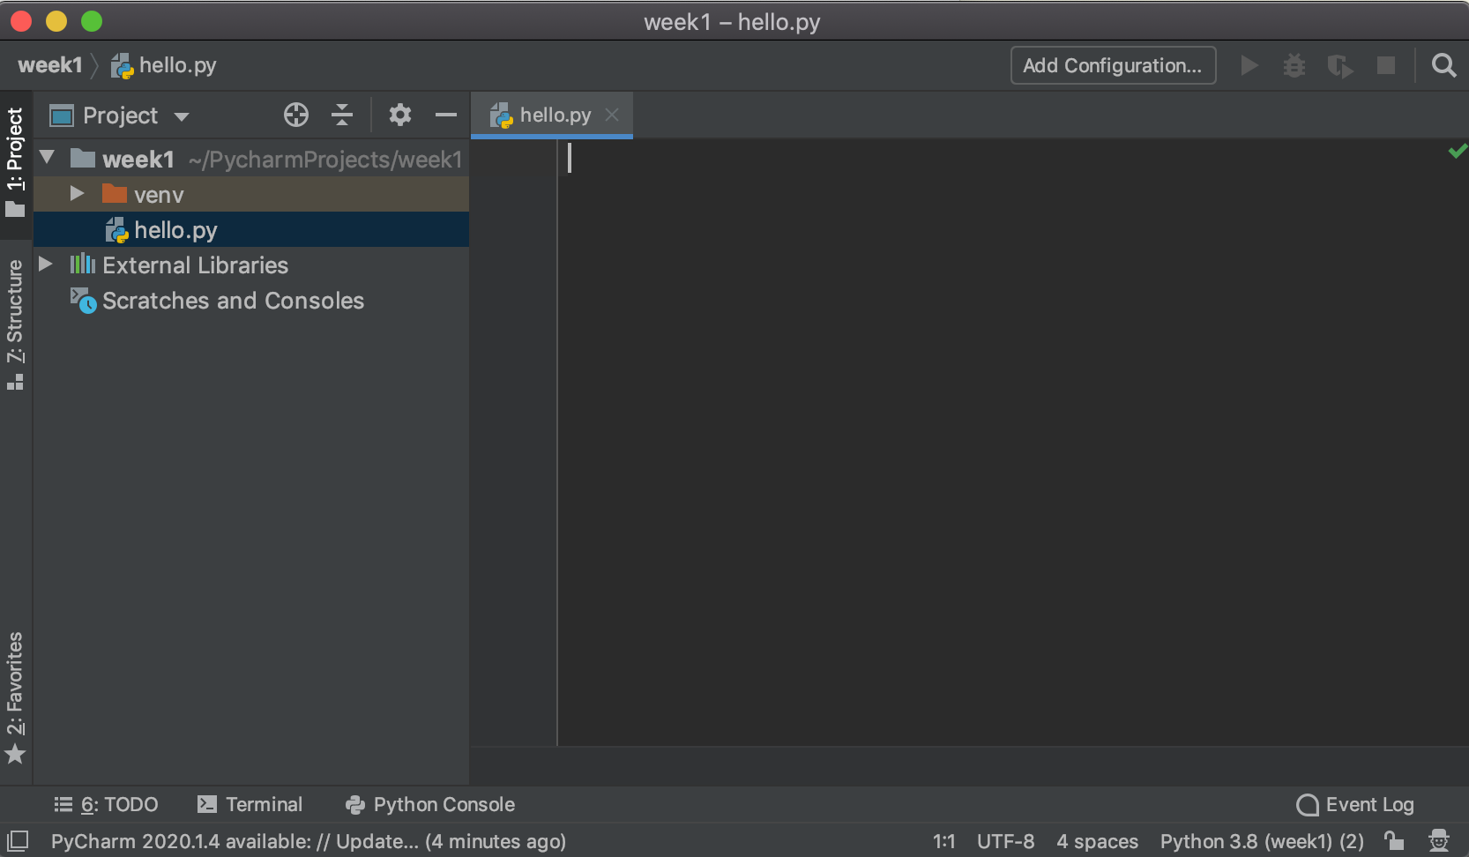
New hello.py file
The new file should open for editing
Can you see your new file in the project files, on the left?
There's also a directory with a red folder icon called venv. Your project needs it, but we'll ignore it

Slide 35
Code - Hello World
Traditionally, the first program that a programmer will write in a new language is called a Hello World program
This is a very simple program that displays the message "Hello World"
Even though it's very simple, being able to write and run a Hello World program means that you have your development environment set up correctly

Slide 36
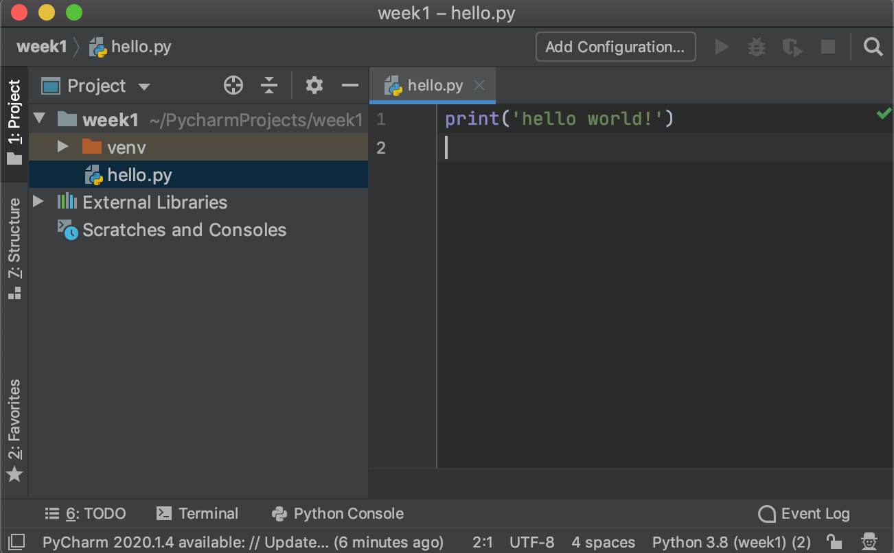
In your editor, please type this code
print('hello world!')
Watch the quotes, and the parenthesis
If you see red underlines, verify you typed the code exactly as shown
PyCharm might fill in the close quote and close parenthesis for you

Slide 37
Running your code
Or, asking the Python interpreter to read your code, figure out what it means, and follow the instructions you've written to do the task

Slide 38
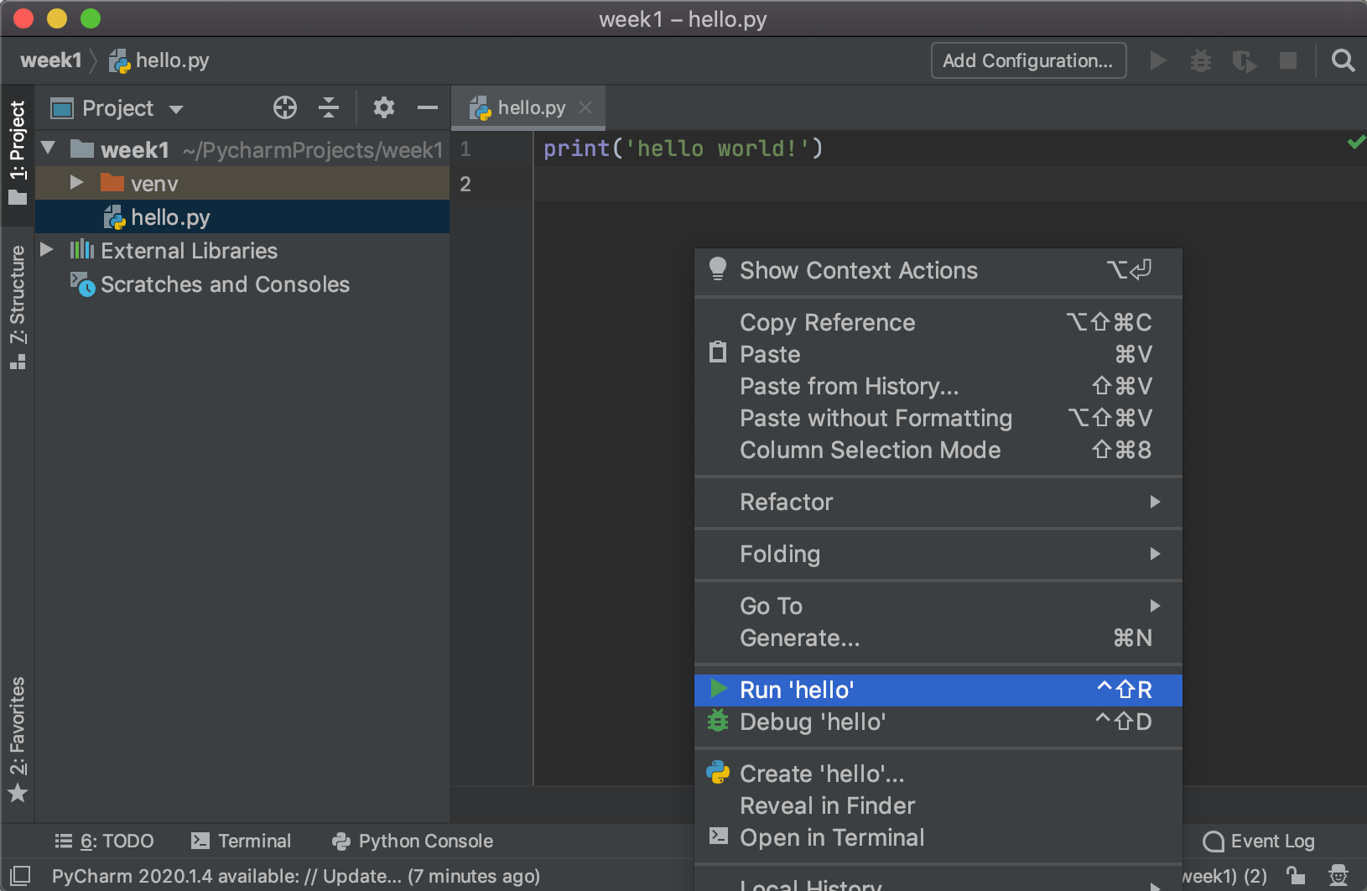
Running your code
Right-click anywhere in the editor window
In the menu, click Run 'hello'

Slide 39
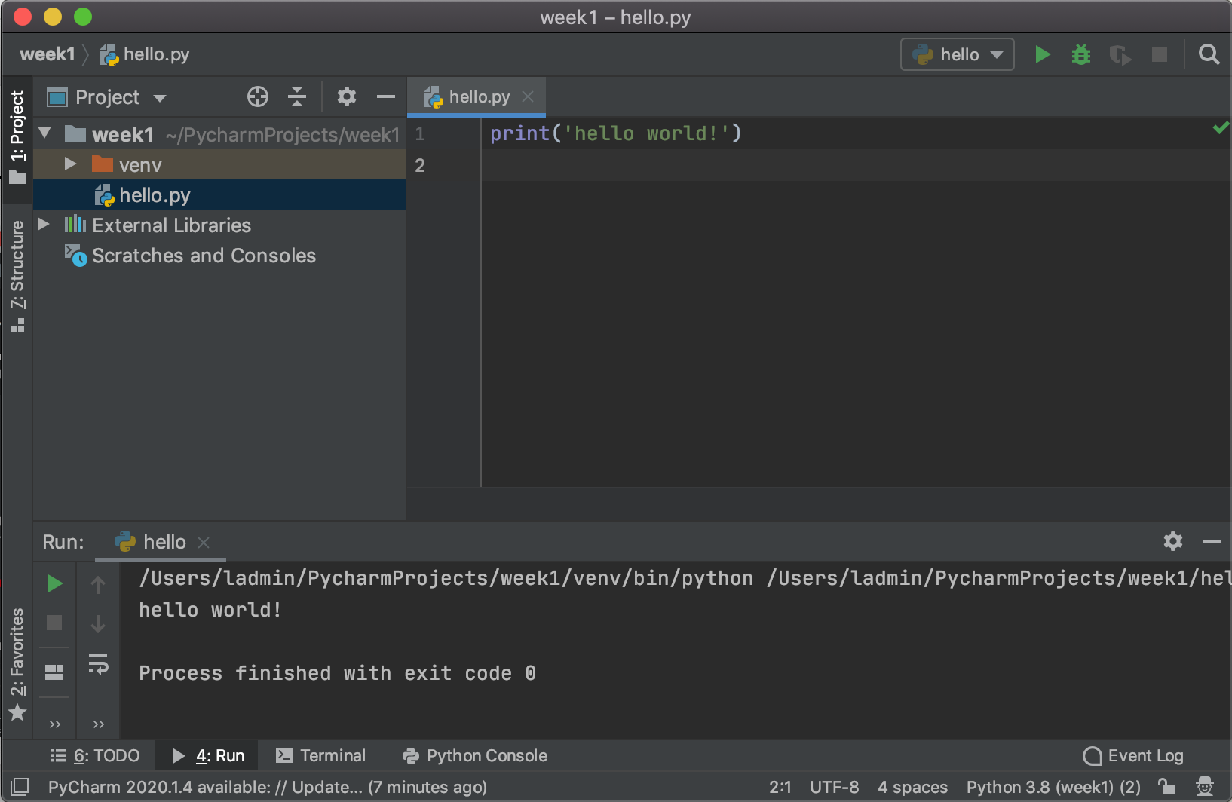
Results of running code
PyCharm asks Python to run your program
New panel opens at the bottom of the PyCharm window, with the results of running your program
Can you see the hello world! message?

Slide 40
Problems? Errors? Something unexpected?
Please ask for help!

Slide 41
You are now a Python programmer!
Well done!!

Slide 42
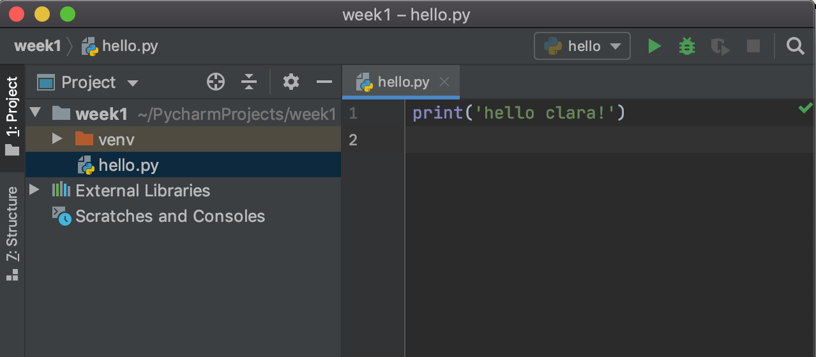
Can you change your program to say hello to you?
Modify your program so it says hello to you
I changed my program to this: print('hello clara!')
When you modify yours, use your name

Slide 43
Run your program again
You can right-click on the editor and select Run 'hello' as before
Or, once you have run a program once, a green triangular play button appears in the icon bar
Click the green
button to run your
program again
Click this to run the program again

Slide 44
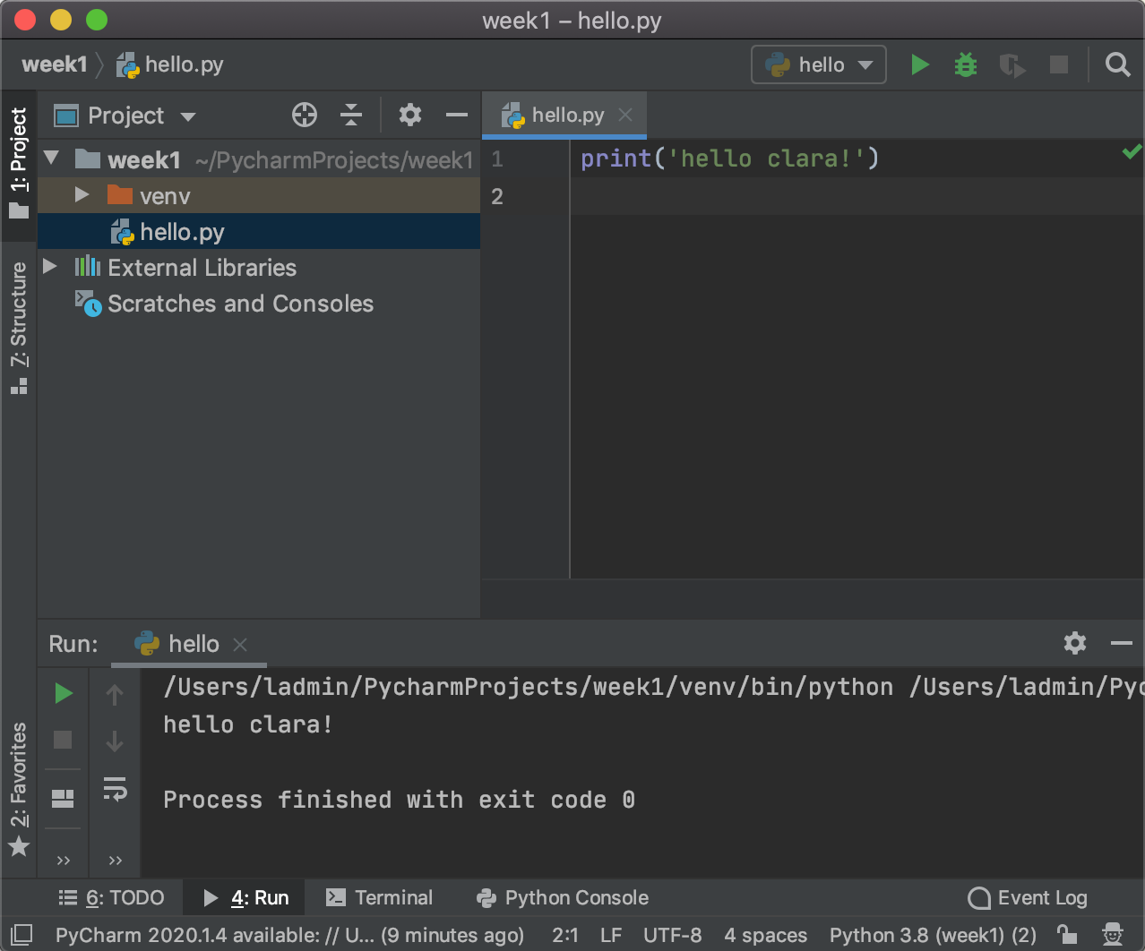
Output
Look at the output - do you see the new message?
This should say hello to you

Slide 45
Did it work? Do you have any questions?
Please ask for help!

Slide 46
Questions? Errors? Problems?
Programming is complicated
Everyone's computer is different, so you might run into errors or unexpected behavior
It’s very, very rare for a program to work perfectly the first time – even for professional programmers
And that's expected!
So please don't feel bad if your program doesn't work the first (or second or third or fourth…) time, or you see some weird error message
IT professionals are paid to fix problems so running into problems, and figuring out how to fix them, is good practice
So if something doesn't work, or doesn't look right...
Review and see if you can figure out what's wrong
If you can't fix it, or are still concerned, ask for help!

Slide 47
Questions, any time? Please get in touch!
email me: clara.james@minneapolis.edu
Come to open lab held every Wednesday 12.30-1.30 via Zoom, link in D2L. All welcome, any time during open lab, no appointment needed
Even if you don't have questions, you are welcome to join
Email me to set up an appointment for a Zoom session
Text or call me: 612 460 1159
Message me on Slack - join the https://mctc-itec.slack.com/ group with your school email, or email me for an invite with another email
Tutoring: the Academic Success Center has tutors who can help with your assignments
We are here to help you – so please ask for help if you need!

Slide 48
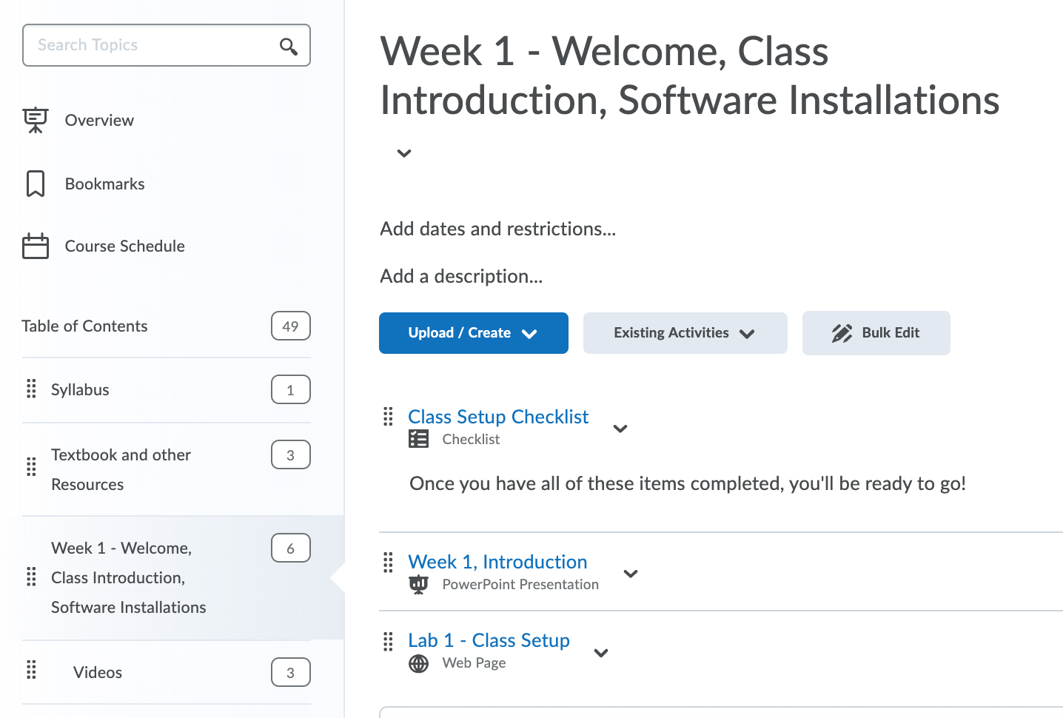
Lab 1 – Due Sunday
In D2L, go to Materials > Content > Week 1
Open Lab 1 – Class Setup
This week, your lab is making sure you have everything set up for the class
Usually, labs are programming tasks
Make sure you've done all the items, and upload a message to the Lab 1 Assignment Dropbox letting me know
The assignment dropboxes are in D2L, under Assessments > Assignments

Slide 49
Lab 1 Tasks
Instructions:
Make sure you have the textbook, or you've bookmarked/downloaded the online version
Read the introduction to the textbook. https://automatetheboringstuff.com/2e/chapter0/ Skip the Installing Mu, Starting Mu, Starting IDLE, Installing 3rd Party Modules sections. Mu and IDLE are both Python editors. In this class, we'll install and use PyCharm instead.
Make sure you have access to a Python development environment, either on your own computer, or you can access the Academic Success Center labs. If you prefer to use your own computer, install all the required software (Python and PyCharm Community Edition). Instructions for installing on your own computer are are in this PowerPoint Week 1, Introduction and the accompanying videos.
Make sure you can run the Python Hello World program.
Read the entire syllabus.
Make sure you know what the activities and assignments are for each week.
Finally, think about any questions or concerns about the class.
To submit:
Write
a short message confirming that you've done all the tasks above
any questions or concerns you have
Upload this message to the Lab 1 assignment dropbox here: Lab 1 - Class Setup

Slide 50
Wrap Up
Thank you!
Contact me if you have any questions or concerns
Next week: we'll add more instructions to our programs and start working towards writing programs that do more interesting things
See you same time next week!

